Slide 1

Intellectual Property Rights and their value
Dr. M. PadmavatI
Professor
Rajiv Gandhi School of Intellectual Property Law
IIT Kharagpur

Slide 2
Overview
Importance of IP
Types of IP & their characteristics
Indian IP law
IPR Strategy
Prior art search- An early run for IP

Slide 3
Research and Development
Experiments
Identification of new process/product/both
Intellectual Property compliance and building novelty is key for research
Prototype
Technology transfer
Patent filing
Technology transfer

Slide 4

Ways to develop an innovative mind set
Is IP search compulsory in your research methodology?
Are we creative?
Do we understand gaps in research?
How wide is our reading approach?
Do we network for research?
What value addition to we want to bring to society?

Slide 5
What is the problem to be solved?
Inventive step
What is the solution?/What are the solutions?

Slide 6
Why are Intellectual Property Rights important?
To protect against counterfeit
To obtain economic advantage
Defensive protection

Slide 7
Some aspects of IP
Journey
The development of intellectual Property system
Industrial revolution – First industry to be impacted was agriculture- Agricultural machinery
Development of the IP system and growth
Intellectual Property – International basis
Substantive and Procedures for IP vary in different countries
Expansion of the nature and scope of IP
Need for protection of manufactured articles and industrial products outside the territory
IP Laws are jurisdiction specific
Economic and Philosophical justifications
IP as a tradable good
Journey from the 1883 Paris Convention on Industrial Property to the 1994 Trade related aspects of IP Rights
Post TRIPS – Inclusion of the ‘development dimension’

Slide 8
TRIPS has made IP a global obligation
Differential treatment of patents
In individual countries
Post TRIPS agreement member countries
Agree ‘shall be available for any inventions,
whether products or processes, in all fields of
technology, provided that they are new, involve
an inventive step and are capable of industrial application

Slide 9
Firms are only into technology transfer
Firms participate in joint manufacturing
Firms are set up for new manufacturing
Firms enable technology development
Indian Start Up Scenario
Understanding the legal and regulatory regime is essential for firms who are
- Exporting to India
- Manufacturing products in India
- Licensing IP in India
Key to Atmanirbhar Bharat- Reduce imports and depend on indigenously developed products

Slide 10
Forms of Intellectual Property Rights

Slide 11
Trade Secret
Data compilations, for example lists of customers (the more information a list contains, the more likely it is to qualify for trade secret protection), for example a list of customers ranked by how profitable their business is;
Designs, drawings, architectural plans, blueprints and maps;
Valuable business information such as business strategies, methods of doing business and marketing plans, for example a company's plan to launch a new product;
Costs and price information;
Information about research and development activities;
"Negative know-how", for example research revealing that a new type of drug is ineffective;
Informal IP

Slide 12
Algorithms and processes that are implemented in computer programs, and the computer programs themselves;
Manufacturing technology or repair processes and techniques;
Document tracking processes;
Schedules, manuals, ingredients;
Prototypes;
Formulas, for example the formula of Coca-Cola

Slide 13
Any information, including but not limited to technical or non technical data, a formula, pattern, compilation, programme, device, method, technique, drawing process, financial data, or a list of actual or potential customers or suppliers that:
is sufficiently secret to derive economic value, actual or potential, from the fact that it is not generally known to other persons who could obtain economic value from its disclosure or use; and
Keeping it secret for reasonable time
Protection of Trade secrets
Non disclosure Agreements
Code of compliance
Code of conduct
Advantages
Disadvantages
Greater shelf life
No registration requirement
High value
High risk of losing trade secret
Enforcement of trade secret difficult
Need to develop on existing trade secret

Slide 14

Copyrights
Literary works
Artistic works
Computer program

Slide 15
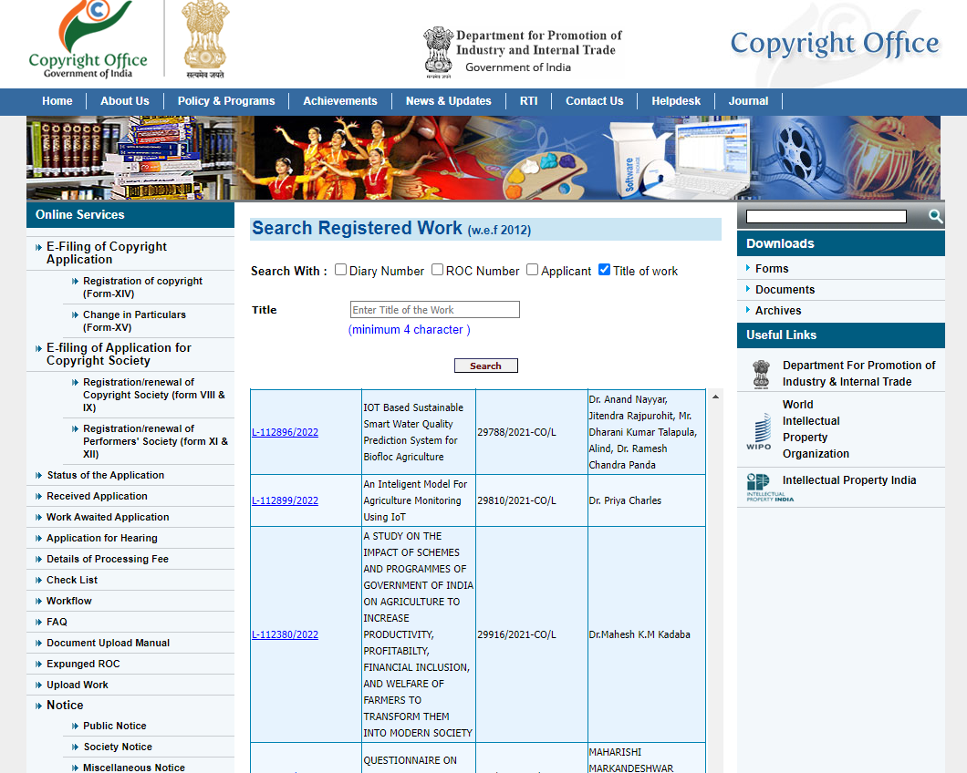
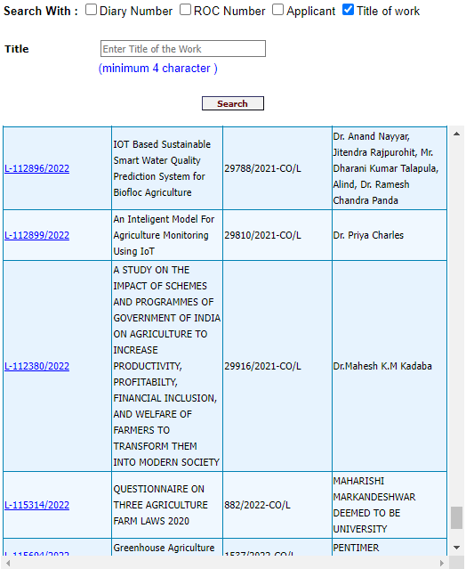
Search for copyright:
https://copyright.gov.in/SearchRoc.aspx

Slide 16
Advantages
Exists by way of creation
Registration if necessary
Fair use for limited purposes
Licensing options
Longest term of protection among all IPRs
Disadvantages
Enforcement of copyright
Search for copyright registered products not yet available
Digital copyright protection measures need to be adopted
Enforcement across borders
Multiple level of protection in the different forms of the product need to be ensured

Slide 17
Demonstration of Search for Copyright @https://copyright.gov.in/SearchRoc.aspx

Slide 18
Basics and Basis of TM
Trademark
Image and reputation in any context can be extraordinarily valuable assets.
In the business contexts, these assets are embodied in trademarks.
Trademarks are distinctive marks of authenticity through which goods or services of a party are offered to the marketplace so as to distinguish them from the goods and services of others, whether competitors or otherwise.
Trademarks are the laws recognition of the psychological function of symbols.
Though it comes as names, symbols, brands, logos they all serve the fundamental function of acting as “source indicators”
Hence it is not only beneficial to TM owners but also consumers in finding their goods and manufacturers with greater ease.

Slide 19

Categories of trademarks
Well known trade marks
Associated trade marks
House marks
Non traditional marks
Trade Dress

Slide 20
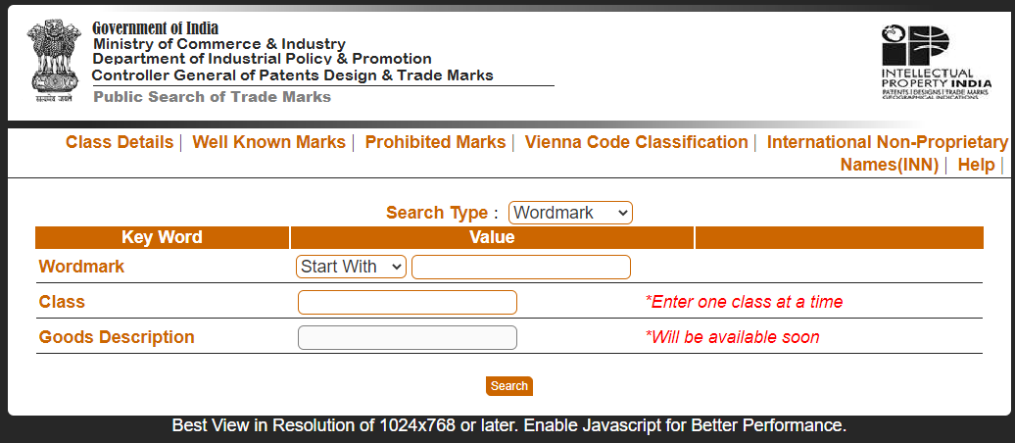
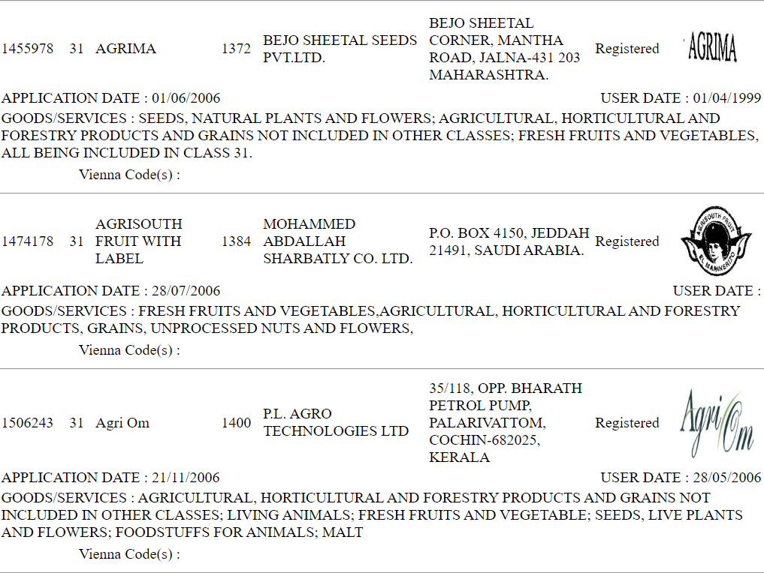
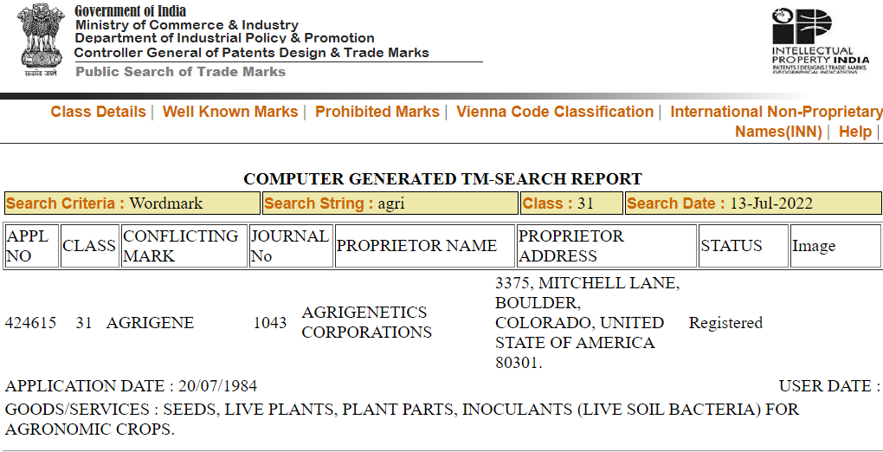
https://ipindiaonline.gov.in/tmrpublicsearch/frmmain.aspx

Slide 21
Advantages
Help in building business brand
Licensing options
Expansion into different sectors
Combining marks
Strong enforcement
Disadvantages
Conditional nature of IPR
Enforcement across borders
Need to maintain goodwill with brand
Genericity

Slide 22
Demonstration of Search for Trademark@ https://ipindiaservices.gov.in/tmrpublicsearch/frmmain.aspx

Slide 23
Patents are given to inventions that qualify as per the requirements of Patent Law
Patents
Subject Matter of Protection
Products
Processes
System
Composition of matter
Criteria for patentability are often difficult to interpret
Multidisciplinary area – issues of resolving eligibility
Prior art considerations
Application of relevant novelty, non-obviousness and utility standards
Enablement issues

Slide 24
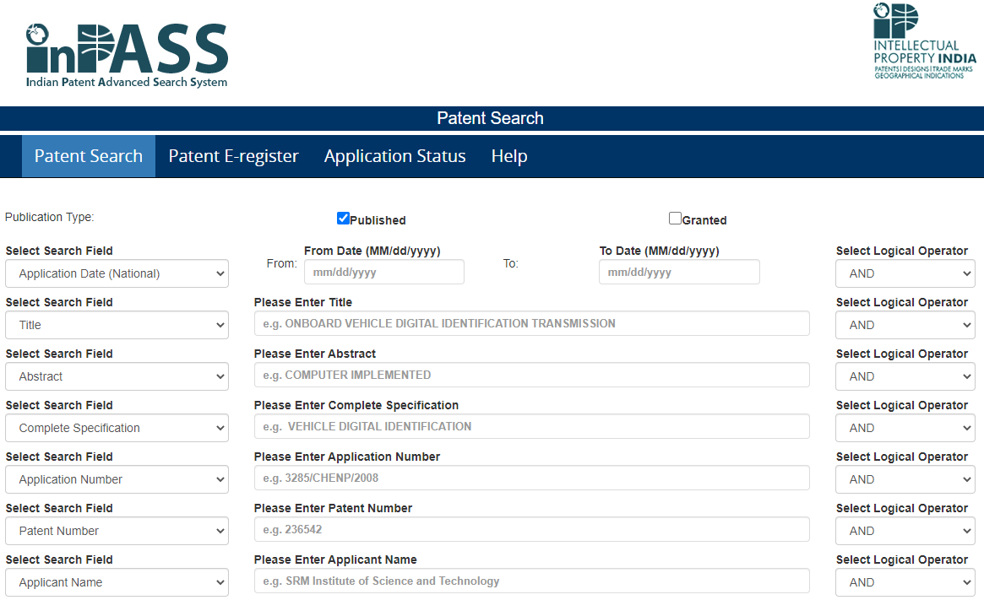
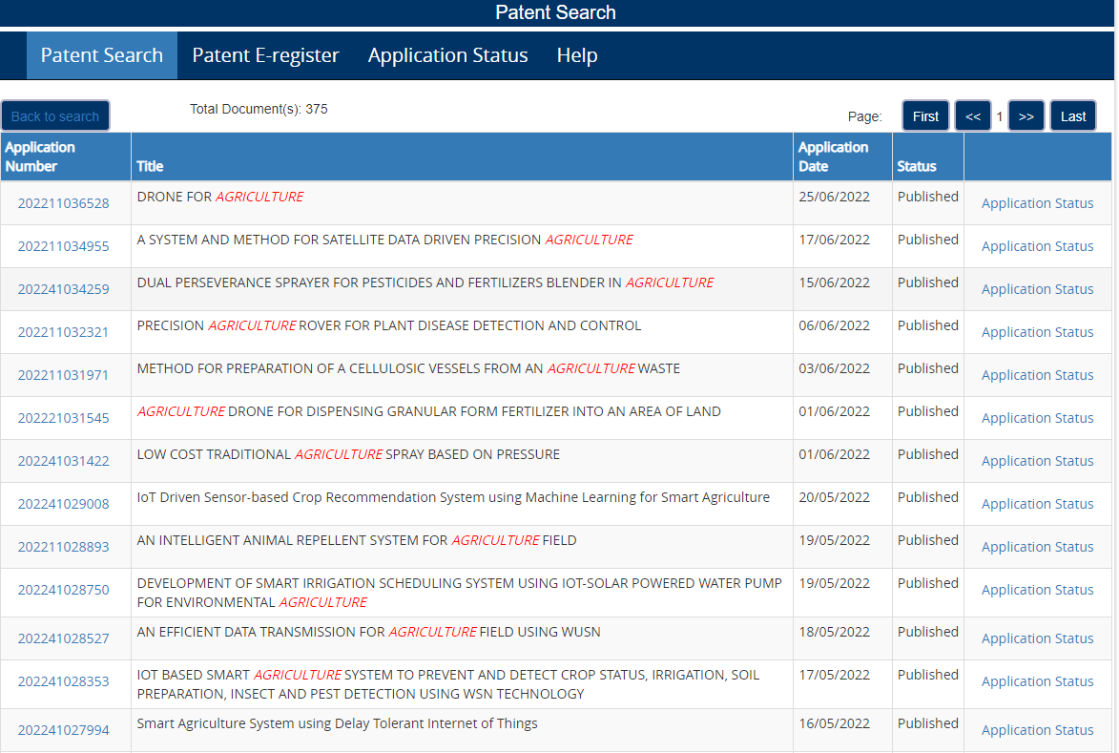

Slide 25
Advantages
Negative rights
Licensing options
Defensive protection
Improvement Patents can be filed – Patent of addition
International Patent filing – single filing window
Strong enforcement
Disadvantages
Market conditions
In certain areas- fast technology obsoletion
Conditional nature of IPR
Costs for patent protection

Slide 26
Demonstration of Search for patents@https://iprsearch.ipindia.gov.in/publicsearch

Slide 27
Industrial Design
Articles of manufacture with industrial value
Ornamental features protection
Non functional aspects of protection
Registration of Design much simpler
Great value to manufacturing industry

Slide 28
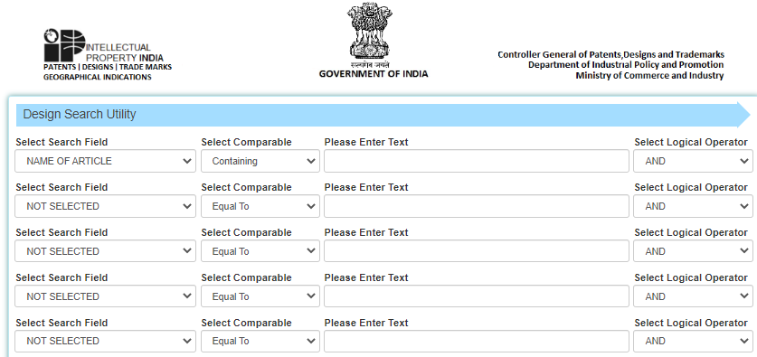
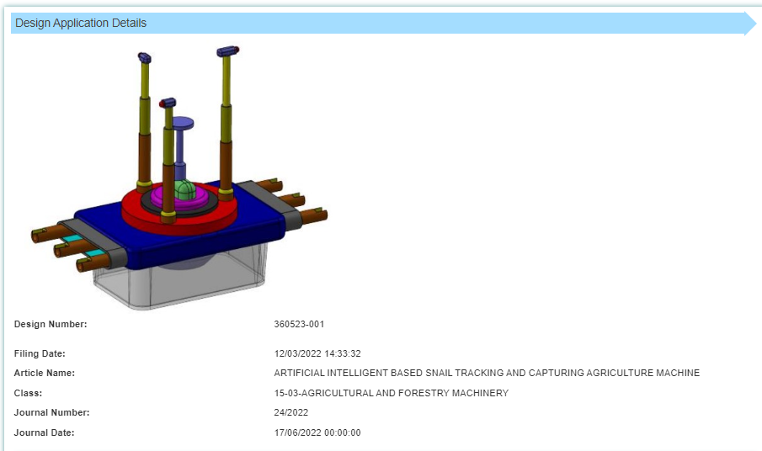
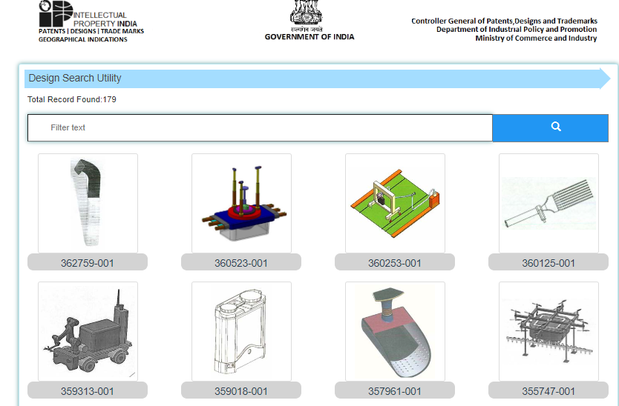

Slide 29
EXAMPLE OF FAN
PATENT
DESIGN
Fig. 1 schematically illustrates a perspective view of a configuration of a propeller fan according to Embodiment 1.
WE CLAIM:
[Claim 1]
A propeller fan comprising:
a shaft provided on a rotation axis; and
a blade provided on an outer peripheral side of the shaft,
wherein the blade has a trailing edge on a rear side of the blade in a rotation direction of the propeller fan, and
wherein the trailing edge includes
a first trailing edge located on an innermost side of the trailing edge, and
a second trailing edge adjacent to and outward of the first trailing edge,
wherein where an innermost point of the first trailing edge is a first connection point, a connection point between the first trailing edge and the second trailing edge is a second connection point, and a straight line that extends through the rotation axis and the first connection point is a reference line, the second connection point is located forward of the reference line in the rotation direction, or located on the reference line, and the second trailing edge is located rearward of the second connection point in the rotation direction

Slide 30
Demonstration of Search for Designs@https://search.ipindia.gov.in/designsearch

Slide 31
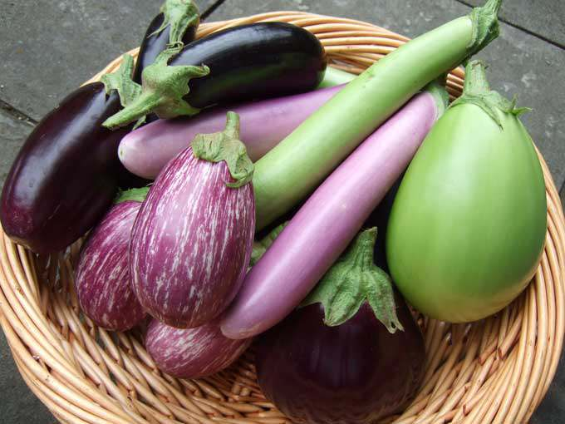
Plant Variety Protection
IP protection to plant varieties?
Economic benefits,
NEW varieties with improved yields lead to reduction in price of end-products for consumers.
NEW varieties with improved quality lead to higher value products.
Health benefits
NEW varieties with improved nutritional content.
Environmental benefits NEW varieties which are disease resistant.

Slide 32
Section 2 (za) “variety”
Section 2 (l) “farmers’ variety”
means a plant grouping except micro organism within a single botanical taxon of the lowest known rank, which can be -
(i) defined by the expression of the characteristics resulting from a given genotype of that plant grouping;
(ii) distinguished from any other plant grouping by expression of at least one of the said characteristics;
(iii) considered as a unit with regard to its suitability for being propagated, which remains unchanged after such propagation, and includes propagating material of such variety, extant variety, transgenic variety, farmers’ variety and essentially derived variety.
means a variety which –
(i) has been traditionally cultivated and evolved by the farmers in their fields; or
( i i) is a wild relative or land race or a variety about which the farmers possess the common knowledge;

Slide 33
Section 2 (i) “essentially derived variety”
Section 2 (j) “extant variety”
is predominantly derived ……
is clearly distinguishable from such initial variety;
(iii) conforms to such initial variety in the expression of the essential characteristics that result from the genotype or combination of genotype of such initial variety;
means a variety available in India which is -
(i) notified under section 5 of the Seeds Act, 1966; or
(ii) farmers variety; or
(iii) a variety about which there is common knowledge; or
(iv) any other variety which is in public domain;

Slide 34
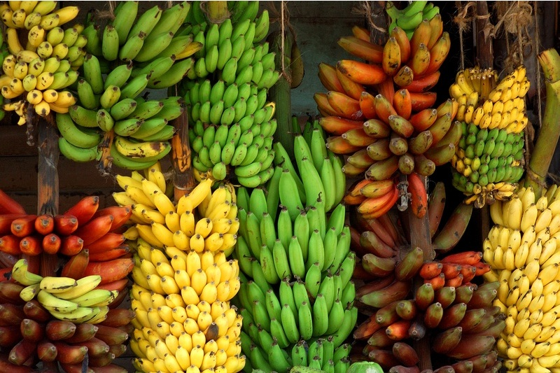
How is IP protection given to NEW plant varieties?
Protection is by registration of the NEW variety
Registration is given to Breeders who developed the NEW variety
Breeders get exclusive rights to produce, sell, market, import, export the registered variety
Plant Breeders Rights (PBR) is alternative to patents

Slide 35
Advantages
Breeder rights recognition
Farmer varieties registration
Expansion of farmer rights
Disadvantages
DUS criteria and testing very elaborate and tedious
Farmer rights enforcement aspects not yet realised
Multiple level of protection in the different forms of the product need to be ensured

Slide 36
Demonstration of Search for plant variety protection@https://plantauthority.gov.in/trace-application-status Plant Variety Journal: https://plantauthority.gov.in/sites/default/files/pvjseptember2023signed.pdf List of Certificates issued: https://plantauthority.gov.in/node/3182

Slide 37
Semi Conductor Lay out Chip (SCLD) Protection
In the semiconductor industry IP is in relation to a semiconductor Intellectual Property core. This is also called an IP core or IP block
IP core or IP block is a reusable unit of logic, cell, or chip layout design that is the intellectual property of one party.
IP cores may be licensed to another party or can be owned and used by a single party alone.
This term is derived from the licensing of the patent and/or source code copyright that exist in the design.
Due to the limitations of subject matter protection under Copyright/Design/Patents there was a need for separate legislation for SCLD Chips protection

Slide 38
Geographical Indications
‘Geographical indications’ are indications identifying a good as originating in the country, region or locality in that country.
The quality, characteristics or reputation of such good must be essentially attributable to its geographical origin.
The product must necessarily have its characteristics and quality linked with the geography of the place by way of, for instance, the agro-climatic conditions, soil, human factors
Product-Place Link is a key factor in the determination of GI

Slide 39
SICLD registry@https://sicldr.gov.in/ SICLD Journal: https://sicldr.gov.in/Resources/journal/journal_july_2023.pdf

Slide 40
Geographical indications are understood by consumers to denote the origin and quality of the products.
Protection of GI helps preserving the ability of the product to be made in the traditional manner by preventing the development of generics
The use of GI enable producers to obtain market recognition and often a premium price. In internationalization product markets, GI have become a key source of niche marketing (Tea and Textiles from India)
Disadvantages
Advantages
Socio-economic right
Community right
Benefit sharing
Helps in increase of market value
Enforcement of GI
Need for authorized user registration
Origin of GI – transboundary aspects of GI
Enforcement across borders
Genericity

Slide 41
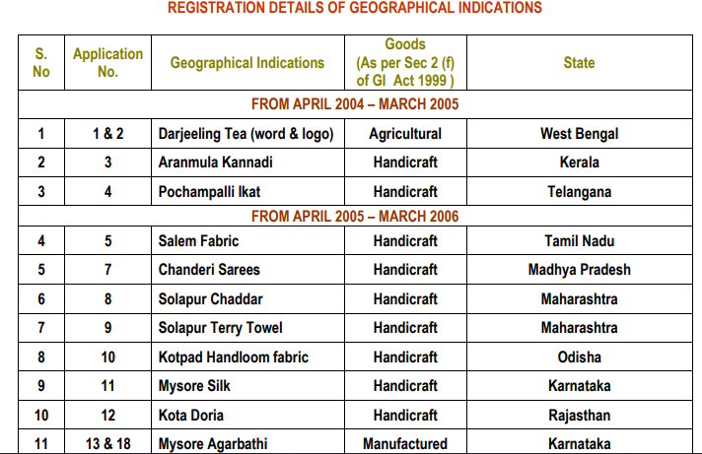
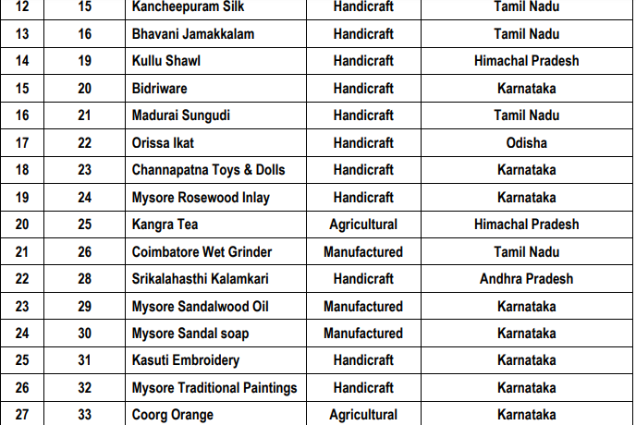
Source: https://ipindia.gov.in/writereaddata/Portal/Images/pdf/Year_wise_GI_Application_Register_-_31-08-2023.pdf

Slide 42
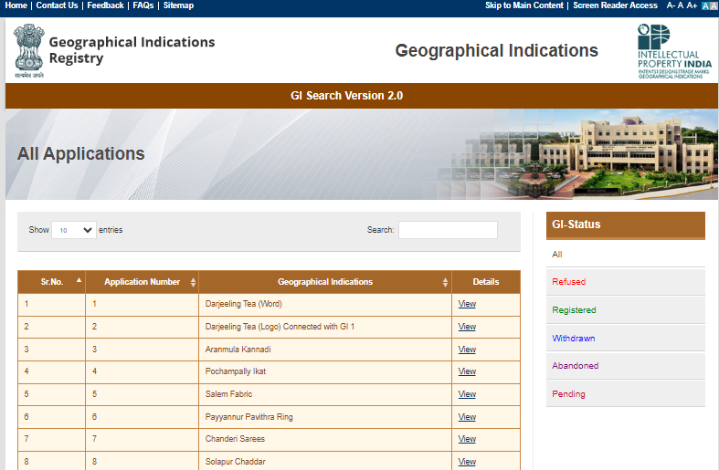
GI Registry

Slide 43
IP Strategy for Start Ups
Intellectual Property Rights help in providing exclusivity in market
Ability to transact with the Property rights – license, rent out, sell
Intellectual Property Rights provide investment opportunity
Intellectual Property Rights can assist in global reach of markets
Intellectual Property Rights provide investment opportunity
Intellectual Property Rights provide collaborative opportunities
So, how do you develop a good IP strategy
Live discussion with one Agri-Start up participating in the webinar

Slide 44
Early capture of IP is possible with a good prior art search and a filing strategy
What is prior art?
Difference between the invention and what is already known
Public use
Publications – Patent, Non Patent Literature
Meeting reports
Survey reports
Clinical trial information if not indicated as ‘sample’
Oral disclosure or TK defensive publications
Prosecution History
Example of patents:
An invention must be new and not obvious
Novelty
Prior art relation
Non-obviousness
One to one – Identity – Novelty
One to many- Mosaic – Non-obviousness

Slide 45
In India a patent application will be anticipated:
Prior publication in a publication (with exceptions)
Prior publication in a claim of a complete specification
Prior display (with exceptions)
Prior communication to Government (with exceptions)
Public working
Public knowledge
Prior art
Invention
Novelty is lost when
Identity is met
Prior art 1
Invention
Prior art 2
Utilising the ‘economic significance’ approach:
Reduced number of steps
Low cost
Biodegradable
Environmentally safe process/product
Ease of use
Non toxic approaches
Prior art 3
When multiple prior arts can be combined to reach the invention
Obviousness is met

Slide 46
Class exercise of Product to IP mapping – Individual student exercise

Slide 47
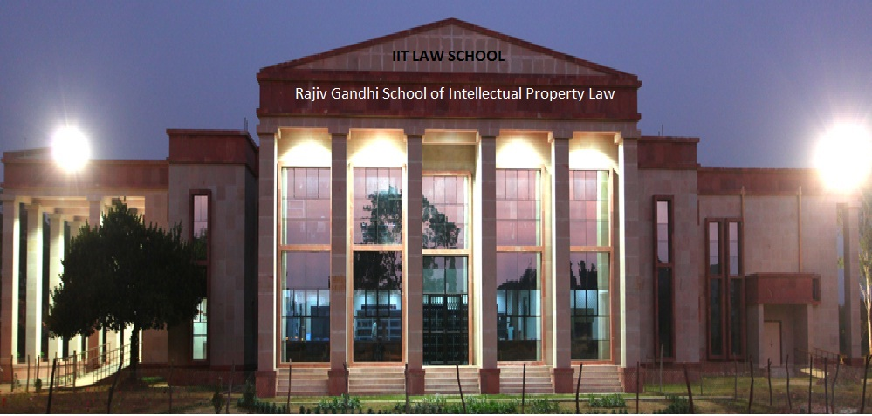
NPTEL Courses:
Patent Search for Engineers and lawyers-https://onlinecourses.nptel.ac.in/noc23_mg99/preview
Biodiversity Protection, Breeder Rights and Farmer Rights-https://onlinecourses.nptel.ac.in/noc23_lw06/preview
Thank you for the attention! Email: mpadma@rgsoipl.iitkgp.ac.in
padmavati@gmail.com

